Slide 1
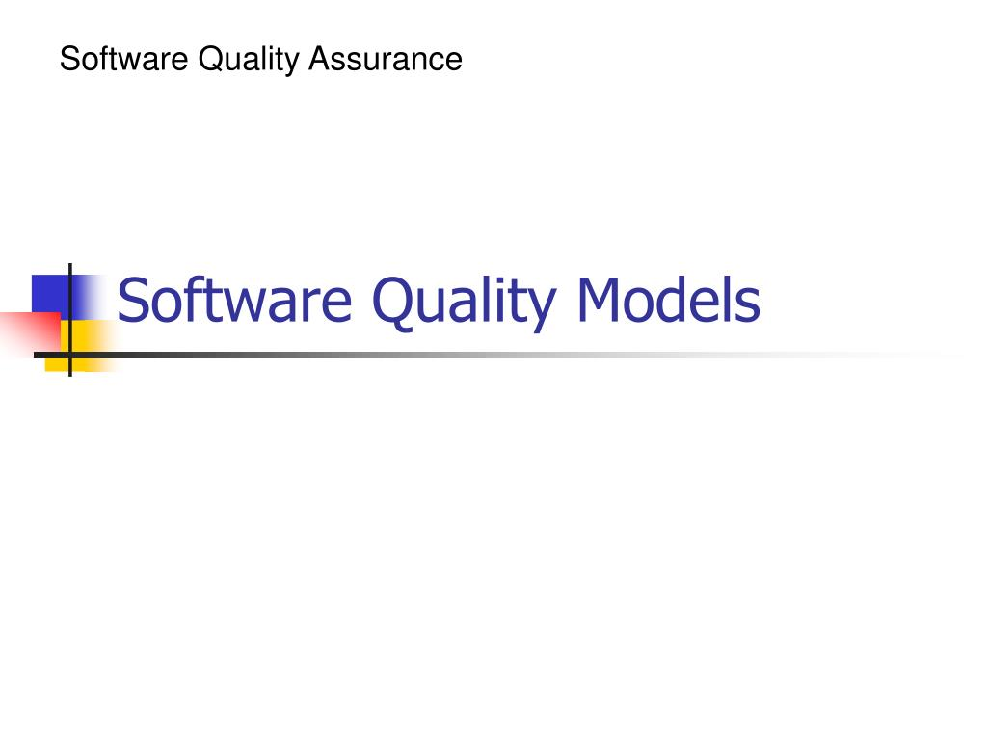

Slide 2
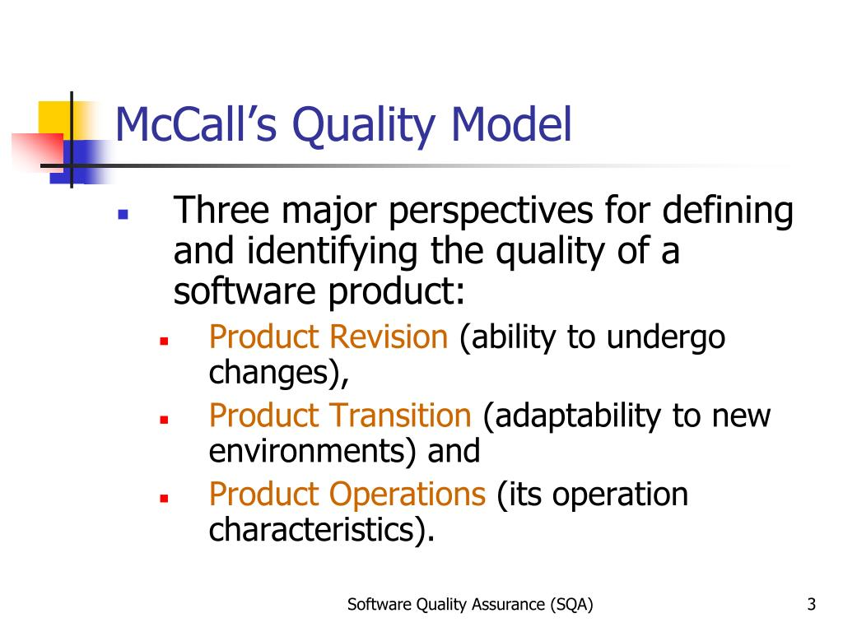

Slide 3
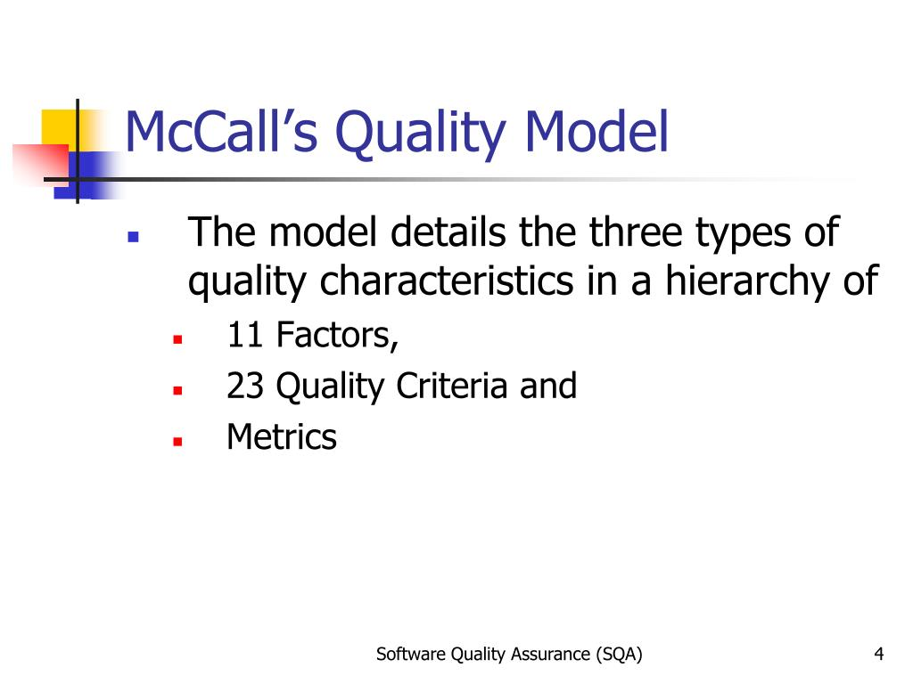

Slide 4
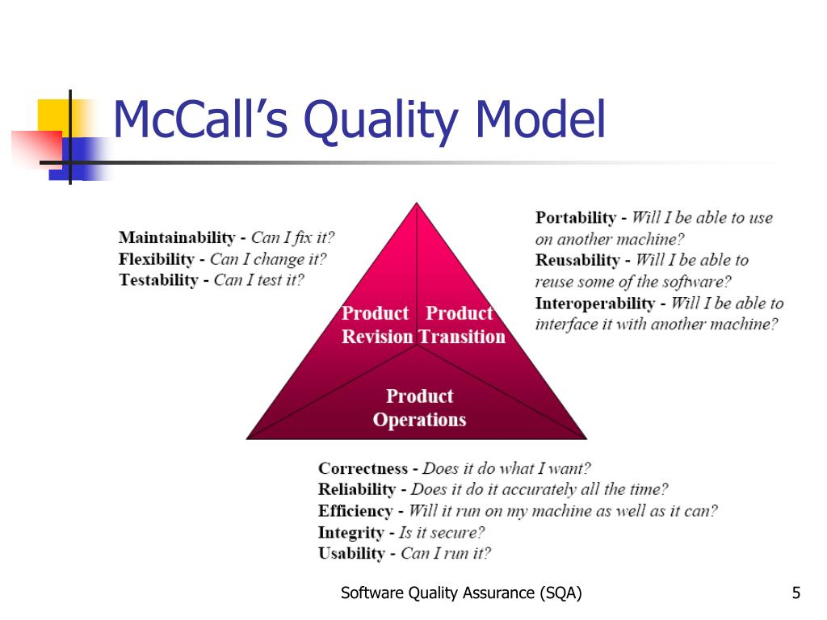

Slide 5
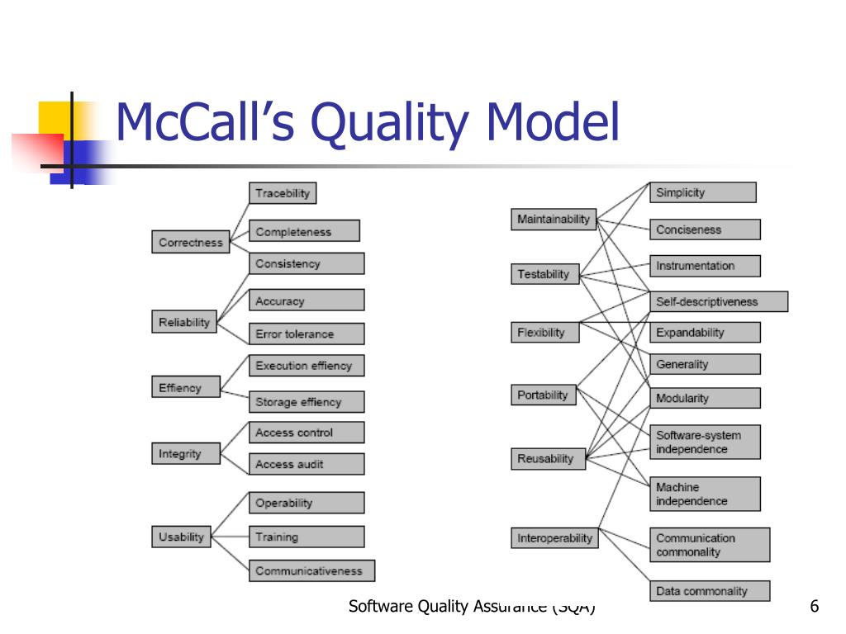

Slide 6
HP Quality Model
The HP Quality Model in software engineering is a framework developed by Hewlett-Packard (HP) to ensure high-quality software products. It defines a structured approach for evaluating, measuring, and improving software quality across various dimensions. This model emphasizes quality as a multidimensional concept, incorporating technical, functional, and user-focused aspects.

Slide 7
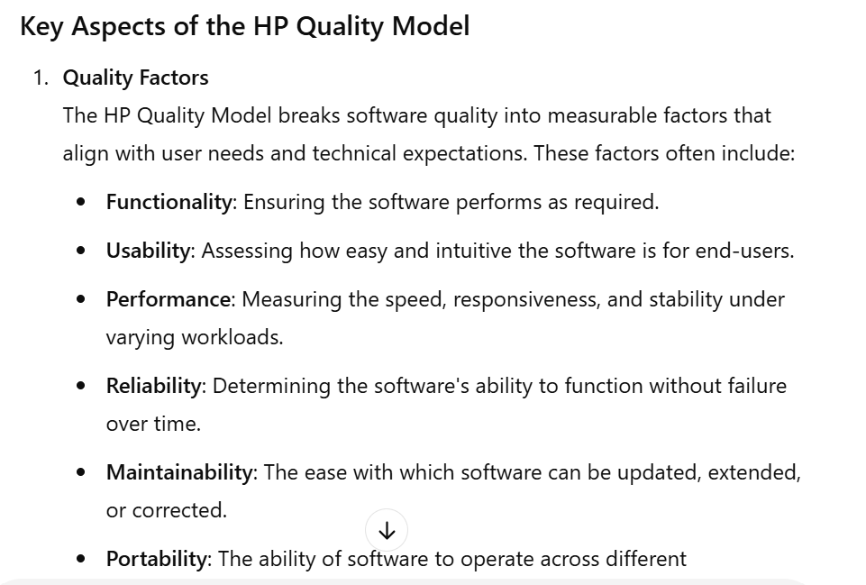


Slide 8
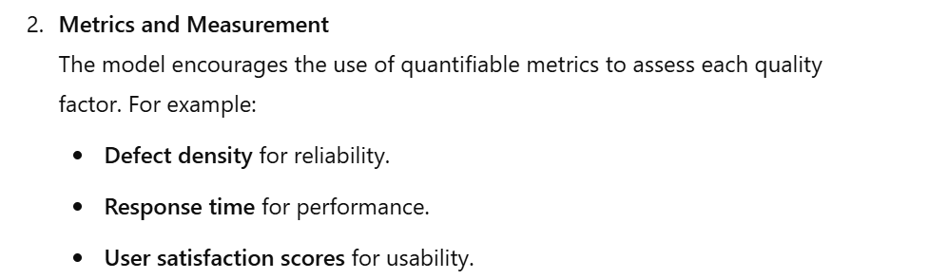
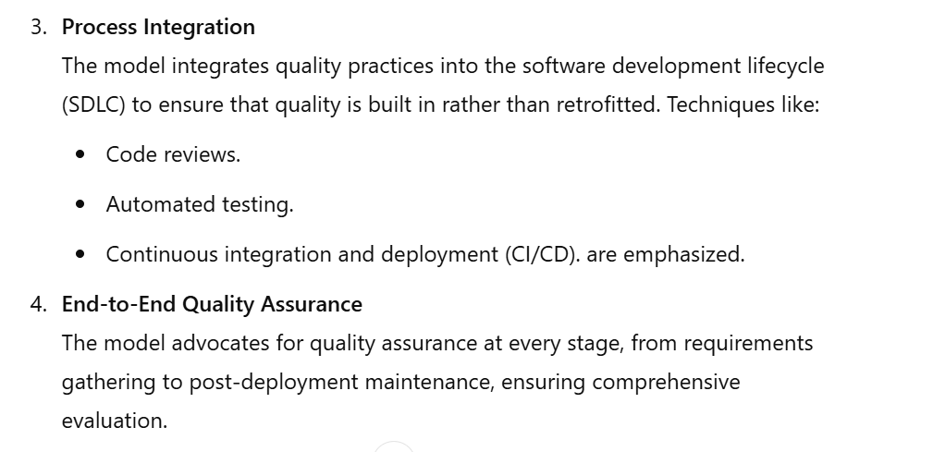

Slide 9
